Slide 1
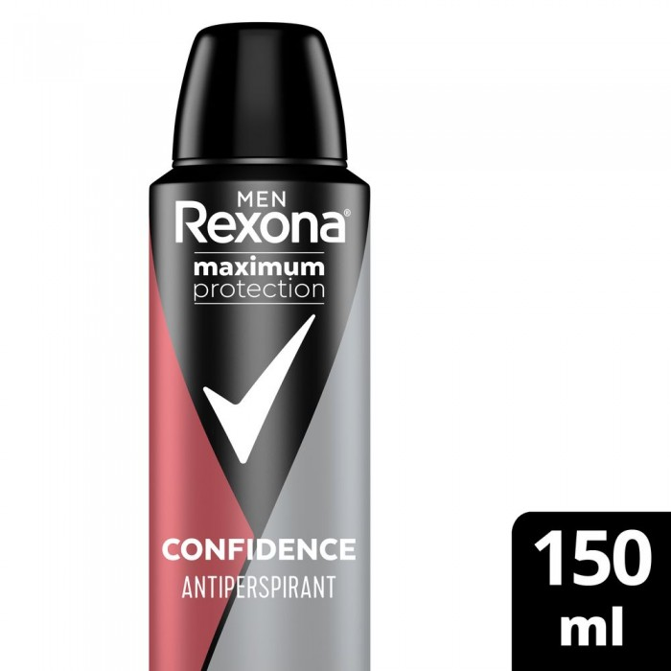
Rexona
Rexona Antiperspirant Confidence Spray For Men 150 ml
150ml
SAR 40.25 Q
Method of use:
- Shake the packaging well. Hold her 15 centimeters from the armpit and spray.
- Do not use on inflamed skin.
- Do not spray on clothes.

Slide 2
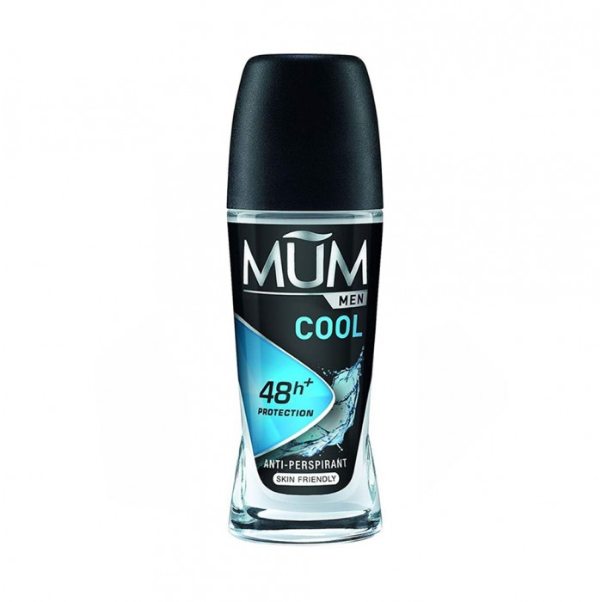
Mam
Mam Roll on Cole Deodorant for Men 50 ml
13.80 SAR Q

Slide 3
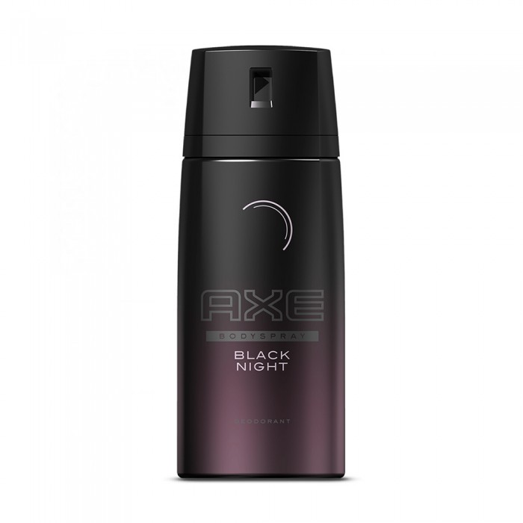
X
X Black Night Deodorant Spray For Men 150ml
35.65 SAR. Q
Usage:
Sprinkle deodorant on the body after shower to give a refreshing smell throughout the day

Slide 4
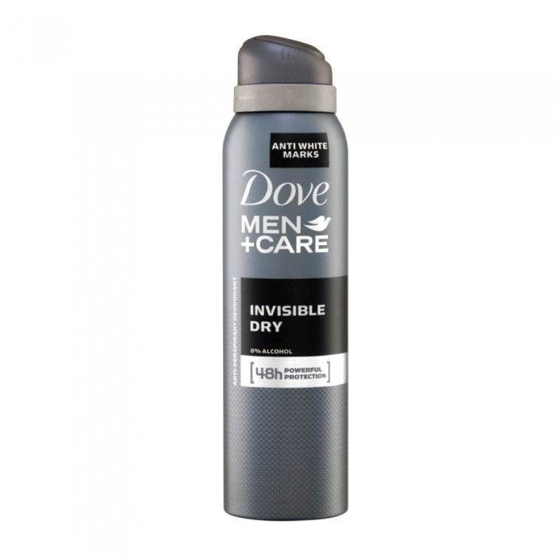
Dove
Dove Sweat Spray For Men Dry Invisible
150ml
SAR 34.50 Q
Dove anti-sweat spray for men, fights sweat and body odor up to 48 hours. It has a hydration technique to help combat skin irritation. It's strong on sweat, not skin. Stop the appearance of white marks on your clothes using deodorant Dove Min + antiperspirant care and invisible dry. This powerful spray is tested on 100 colors, and it dries when shocked, so it leaves no visible residue and keeps clothes free of stains.

